Slide 1
Presents
OO Programming with Java
Inheritance
Notes:
Inheritance
Module 9

Slide 2
Learning Objectives
Overview of inheritance in Java
  The “Is-a” Relationship
Inheritance models
The extends and super keywords
Extension, overriding, and overloading

Slide 3
Chapter Overview
Now that we’ve gotten a better sense of Java programming and an introduction to inheritance, let's look at it more closely.
After reviewing the basic ideas, we’ll introduce three important new ones:
  Overriding
  Overloading
  The super keyword

Slide 4
Inheritance Overview
An inheritance relationship is one of the fundamental mechanisms for code reuse in object oriented programming.
Inheritance allows new classes to be derived from an existing class.
  The class that inherits is called: the subclass, the derived class or the child class.
  The class that is inherited from is called: the superclass, the base class or the parent class.
A subclass inherits attributes and methods from its superclass and all of its ancestors.
Notes:
A subclass is a class that extends another class. It inherits state and behavior from all of its ancestors. The term "superclass" refers to a class's direct ancestor as well as to all of its ascendant classes.
The access modifiers assigned to the attributes and methods determine whether the subclass can directly access that resource.
Public, protected and package level attributes and methods can be accessed directly (assuming the subclass is in the same package as the superclass).
Private methods cannot be called and private data members cannot be read from or written to directly by the subclass.

Slide 5
Inheritance in Java
The general form of subclass:
public class subclassname extends superclassname{
attribute declarations;
method declarations;
}
  The keyword extends signifies that the attributes and methods of superclassname are extended to subclassname.
Notes:
In Java, the keyword extends is used to implement the concept of inheritance.

Slide 6
java.lang.Object
If a class does NOT include the extends keyword, it is assumed to extend java.lang.Object.
All Java classes ultimately inherit from Object.
This means that all classes in Java share the methods found in Object.

Slide 7
Object Class Method Summary
Object clone() - This method may be called to create a new copy of the Object
boolean equals(Object obj)- Determine whether this Object is semantically equal to another Object
void finalize() - Called on an object by the Virtual Machine at most once, at some point after the Object is determined unreachable but before it is destroyed from memory
Class getClass() - Returns the runtime Class of this Object
int hashCode() - Get a value that represents this Object, as uniquely as possible within the confines of an int
void notify() - Wakes up one of the Threads that has called wait on this Object
Notes:
Do not use finalize() as it is not guaranteed to be called, and if it is called we don’t know when it will be called as it is used only by the garbage collector thread.

Slide 8
Object Class Method Summary (con’t)
void notifyAll() - Wakes up all of the Threads that have called wait on this Object
String toString() - Convert this Object to a human-readable String
void wait() - Waits indefinitely for notify() or notifyAll() to be called on the Object in question
void wait(long ms) - Waits a specified amount of time (or indefinitely if the time specified is 0) for someone to call notify() or notifyAll() on this Object
void wait(long ms, int ns) - Waits a specified amount of time (or indefinitely if the time specified is 0) for someone to call notify() or notifyAll() on this Object (provides finer control over wait time)

Slide 9
Inheritance in Java
Multilevel Inheritance
  Multilevel Inheritance allows several levels of superclass.
  In Java a class can only extend from one other class.
A
    A is superclass of B
    B is superclass of C
    This works in Java: B and
    C each have only one
    superclass
B
C
Notes:
In this Inheritance example, there are several superclasses.
Here class C is derived from class B, which is derived from class A.

Slide 10
Inheritance in Java
Hierarchical Inheritance
  Hierarchical Inheritance has one superclass and many subclasses.
A
A is superclass
B and C are subclasses of A
This works in Java
B
C
Notes:
In this Inheritance, there is one superclass and many subclasses.
Here class B and class C are derived from class A.
An example to explain the hierarchical inheritance is shown as on next page.

Slide 11
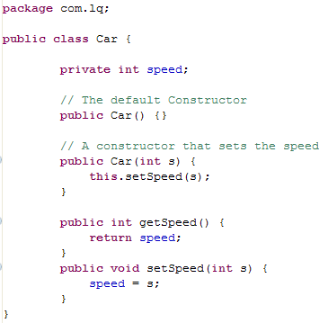
An Example Superclass
Note that Car does not extend any other class so it inherits directly from Object.

Slide 12
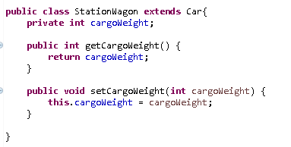
An Example Subclass
StationWagon extends Car and adds an additional attribute as well as a getter and setter method.

Slide 13
Implications of extends
The subclass becomes a specialization of the superclass through one or more of the following mechanisms:
  The subclass adds new attributes and/or methods.
  The subclass overloads existing methods.
  The subclass overrides existing attributes and methods.
The details of overloading and overriding are covered in the next few slides.

Slide 14
Overloading Existing Methods
An overloaded method has the same name as another method in the same class (or in a parent class) but has a different parameter list.
An overloaded method provides specialized functionality by accepting a different set of parameters.
Notes:
Overloading methods is one way that we make a subclass more specific. It is often overloaded methods that give access to the “specialized” functionality of the subclass.

Slide 15
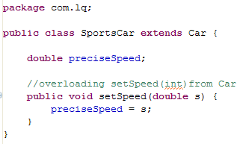
Overloading Example
In our SportsCar class we want the option of setting the speed more precisely via a double.

Slide 16
Overloading Example
STOP!
The example just shown is a perfect example … of what not to do!
The problem is that having written the setter, which does work, what would to do for a getter?
  Car.getSpeed knows about the speed attribute in Car, but not preciseSpeed.
  SportsCar could override getSpeed, but that returns an int, so the precision would be lost. And if SportsCar.getSpeed were changed to return double, that’s a compiler error, because methods can’t be overloaded based on return type.
Typically, overloading is done at the same level in a class hierarchy.

Slide 17
Overriding Existing Methods
An overridden method is a method, in a subclass, that has exactly the same signature as a method in a parent class.
  Use @Overrides to ask the compiler to warn you if you accidentally overload, instead.
You can overload methods in the same class but you can only override methods in a subclass.
  Overriding exists only in the context of inheritance.
Notes:
You may override most methods, except those marked as “final.”

Slide 18
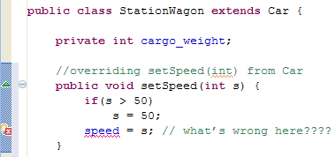
Overriding Example
In our system, a StationWagon is not allowed to go more than 50 miles per hour. We enforce this via an overridden setSpeed() method.

Slide 19
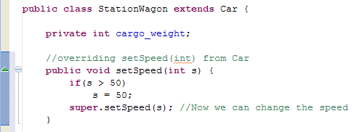
The super Keyword
When you override a method, the code in the parent class method is no longer invoked.
  To access the parent code, you can use the super keyword.
  To call setSpeed() in the superclass Car:

Slide 20
Overriding Existing Data
It is also possible to override attributes.
This is not considered good design practice! You are subverting rather than specializing the original superclass.
Inheritance should not be used to wipe out features that you don’t want in a subclass.
Notes:
Remember, this is sometimes true for inherited methods as well! Override anything with care.

Slide 21
Constructors and Inheritance
In order for objects to be properly initialized, constructors must call their parent’s constructor. This is a chain all the way up to Object.
If you do not define any constructors, Java provides a default no-argument constructor for you:
public MyClass() { super(); }
When you write constructors, if you do not explicitly provide a call to super(…), Java inserts a call to the no-argument super() as the first thing in your constructor.
If you do declare constructors, Java does not provide the default constructor, so if you do not provide a no-argument constructor, there will not be one.
Combine those two ideas. If you do not define a no-argument constructor, subclass constructors must explicitly call super(…) with the arguments for one of the constructors that you did define, or it will be a syntax error.

Slide 22


Constructors and Inheritance
A constructor may include the super() statement to call the constructor of the superclass from which it inherits.
In a constructor, super can only be the first statement in the constructor’s code block (comments excepted!).
This is okay…
…this is not

Slide 23

Constructors and Inheritance
To call a specific constructor in the superclass, the super() statement should be provided with parameters that match that constructor:

Slide 24
The protected Modifier
If an attribute or method is declared as protected then it is accessible to all subclasses.
This accessibility also extends across package boundaries!

Slide 25
The “is a” Relationship
Inheritance should typically be used to model an
“is – a” relationship between superclass and subclass.
  A StationWagon is a Car
  A Penguin is a Bird
  A Factory is a Workplace
While the “is-a” test is a matter for philosophical debate, it is a good metric for building a well engineered inheritance relationship.
Notes:
One of the major design advantages of OO is that it provides a framework that – on some level – captures the semantics of the business processes we are trying to model.
When we ask a question like “Is a station wagon a car?” or “Is a penguin a car?” we should be thinking outside of technical considerations. We should be thinking in plain English.

Slide 26


When “is a” Breaks Down
A penguin clearly “is-a” bird, but not all penguins can fly!

Slide 27


What NOT To Do – Version 1
One (bad) solution is to let Penguins fly() but create a fly() method that doesn’t do anything:
If someone tries to make a penguin “fly” they are probably expecting it to work – somehow. But nothing will happen:

Slide 28


What NOT To Do – Version 2
Another (bad) solution is to give Penguins a fly() method that actually means something else. Perhaps fly() for a penguin should be swim!
This makes the purpose of the code difficult to understand – objects may respond to methods in unexpected, inappropriate ways!

Slide 29
Solution : Refactor the Relationship
Bird
FlyingBird
FlightlessBird
Swallow
Penguin
Refactor the hierarchy into Bird, FlightlessBird and FlyingBird.
Then build your specific class abstractions.

Slide 30
Summary
In this module we:
  Looked at the ways that classes can have inheritance relationships with other classes in Java
  How inheritance is implemented in Java – extends
  Learned how a subclass can access the methods of its superclass at runtime – super
  Showed how to extend, overload and override the methods of a superclass

